Slide 1
Edge Gallery Test Platform (edgeT)---中优先 Integration Testing & Security Testing & app testing
Kanag & Pengyu
22-10-2020

Slide 2
Objective
In Edge gallery various testing scenario involved includes Security test, integration test, use-case test, etc for making edge gallery and application to be very safe with required compliance and ready for deployment
Every testing is performed by using test cases provided by edgegallery community, 3rd party and other parties involved with edge gallery for partner service, app testing.
When testing is performed, the results are generated and those results are required for analytics of app and edge gallery performance and supportability,
Nature of test cases involves with different implementation like java, go, scripts, python, robot, etc
Develop test cases once (either by community or partner or operators or app developer) and use it across at various phases: CICD, app development, production deployment for user-service verification and app certification in appstore, edge gallery platform deployment, use case verification and security check
So One platform for all with required micro-services to manage, execute, run and analyze it in dashboard and integrate with other micro-services and cicd.
CICD
MECM
App Store
Dev
portal
Test Portal
Test Platform
App Deploy
Test cases
App function
Test cases
App security
Test cases
Eg Deploy
Test cases
Eg function
Test cases
Eg security
Test cases

Slide 3
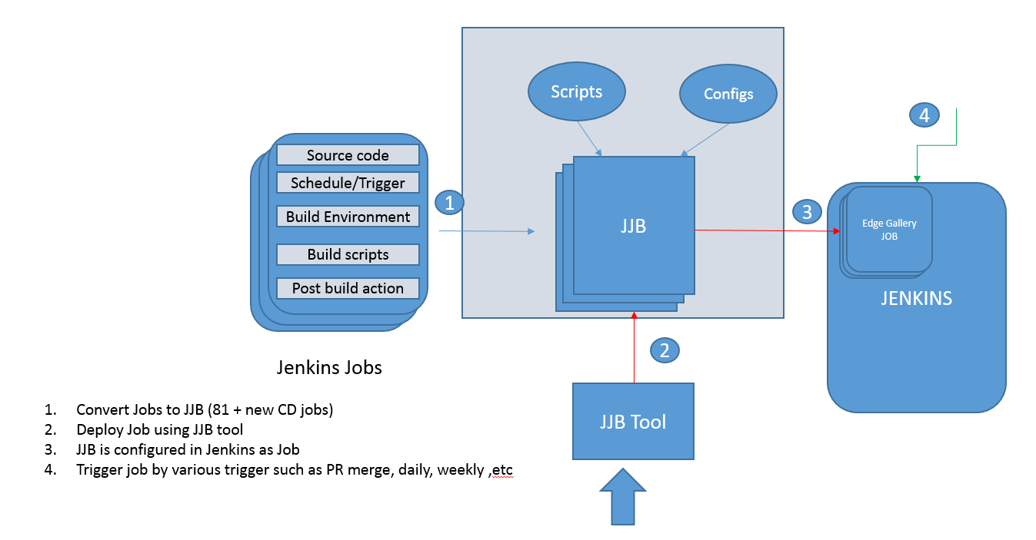
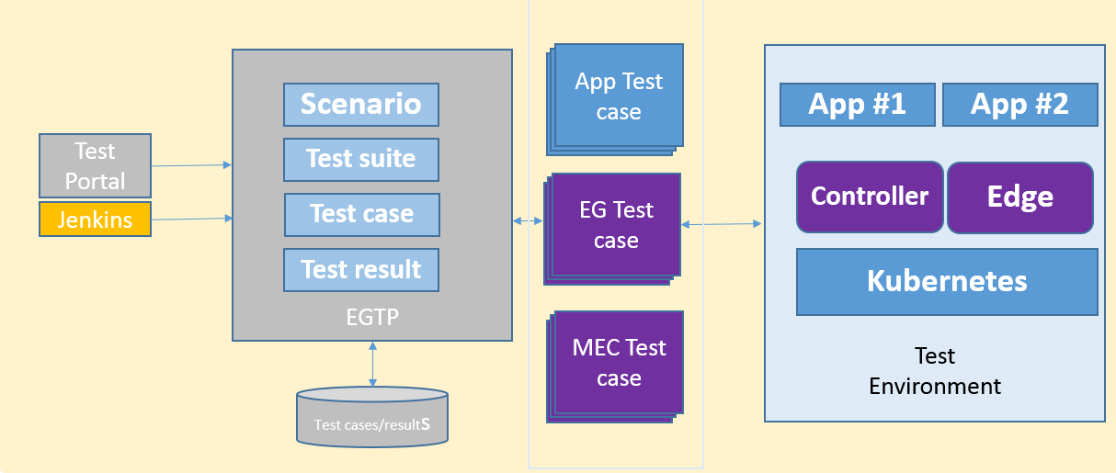
GOAL: Bring Agility in edge gallery and EG app verification
Objective:
Enable Better quality of edge gallery platform
edge app conformance (certification) Platform and apps are secured
Strategy
Make:
Provide agile test automation framework and invites community to add/integrate their test cases
Enable test case modelling and management for reusing existing test cases across certification, devops
Enable Jenkins job for CICD automation helps for improving the quality.
Collaborate
Enable 3rd party integration for app testing
Every company in edge gallery can contribute required testing for app level testing and edge gallery platform testing to improve the quality of platform and app.
1
DEPLOY
2
TEST

Slide 4
ARCHITECTURE: Edge gallery Test platform
Develop test case/suite independently and test it
Deploy test case along with other test case
Develop wrapper test by using existing test case
Search , choose and run the test case(s)
Store the result and analyze it
Test case could be implemented using diff scripts/language
Scenario could be security, integration test and app test
App Test case
Test
Environment
edgeT
App#1
Test case
App#1
Test case
Scenario
App #1
App #2
Test suite
Test
Portal
API
Controller
Edge
EG Test case
App#1
Test case
Test case
App#1
Test case
Test result
Kubernetes
MEC Test case
App#1
Test case
App#1
Test case
Test Tools
Test cases/results
Notes:
Demo code

Slide 5
Integration Testing
Security Testing
Use-case Testing
Deployment Testing
Usecase: CICD
Security Test case
Test
Environment
edgeT
App#1
Test case
App#1
Test case
Scenario
App #1
App #2
Test
Portal
Test suite
Integration E-E Test case
Controller
Edge
API
App#1
Test case
Test case
App#1
Test case
Jenkins
Test result
Kubernetes
Deployment Test case
App#1
Test case
App#1
Test case
Test Tools
Test cases/results

Slide 6
App Dev Testing
Usecase: DevOps
Phase: development
Offline installer
App-store
1. Deploy
2. Download
App Test case
Test
Environment
edgeT
App#1
Test case
App#1
Test case
Scenario
App #1
App #2
Test
Portal
Test suite
EG Test case
Controller
Edge
App#1
Test case
API
Test case
App#1
Test case
Dev
Portal
Test result
Kubernetes
3. Develop
MEC Test case
App#1
Test case
App#1
Test case
Test Tools
Test cases/results

Slide 7
edge service Testing
Usecase: App Test - App Test Platform (ATP)
Phase: deployment
Offline installer
App-store
1. Deploy
2. Download
Edge service Test case
Test
Environment
edgeT
App#1
Test case
App#1
Test case
Scenario
App #1
App #2
Test
Portal
Test suite
EG Test case
Controller
Edge
App#1
Test case
API
Test case
App#1
Test case
MECM
Test result
Kubernetes
3. Deploy App
MEC Test case
App#1
Test case
App#1
Test case
Test Tools
Test cases/results

Slide 8
Certification Testing
Usecase: App(store) Certification
Offline installer
1. Deploy
Compliance
Test case
Test
Environment
edgeT
App#1
Test case
App#1
Test case
Scenario
App #1
App #2
Test
Portal
Test suite
EG Test case
Controller
Edge
App#1
Test case
API
Test case
App#1
Test case
App-store
Test result
Kubernetes
2. App verification
MEC Test case
App#1
Test case
App#1
Test case
Test Tools
Test cases/results

Slide 9
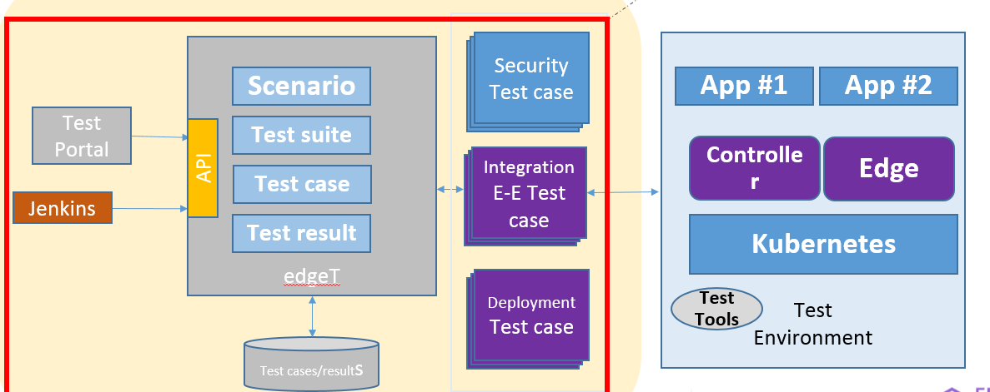
v1.0 requirements
Establish test platform
Test case and suite management
Model(YAML) test case, test suite and scenario and define the
test case artifact (YAML + Implementation tar file) format
Discover the deployed test cases, scenario and test suites
System under test (SUT) management
Create, update, Get, search and delete a given SUT
Test result management
Search test results based on test case, scenario, sut, success rate, test case meta data like compliance standards, etc
Test portal for providing above mentioned features
Workflow: Design->Develop->deploy->Run->analyze->Report.
Enable required Jenkins job in CI pipeline for build and docker build
Enable Integration test cases execution
Enable the IT cases implemented in EG to run on top of test platform.
Add required Jenkins pipeline for CI.
Enable security compliance test cases execution (~next release)
Enable the compliance test cases implemented in EG to run on top of test platform.
Add required Jenkins pipeline for CI.

Slide 10
人力投入
Task | Effort (man-days)
Setup project in gitee | 1
Review with TSC for new project repo 'edgeT' | 1
seed code vtp (controller and engine + plugins) | 3
enable jenkins jobs (pr, docker) | 1
portal support (new feature)—可以裁剪，根据人力情况 | 15
scenario, sut and result management for edge gallery support (updated feature) | 10
REST API review (portal workflow design) | 3
add eg test cases for user-mgmt, appstore, dev, mecm and mep (low priority) | 10
integrate test case support addition | 5

